Slide 1
Enzymes
Biology 9(C)

Slide 2
Enzymes
Learning Objectives
Identify and understand the role of enzymes
Notes:
After this lesson you will be able to identify and understand the role of enzymes.

Slide 3
Enzymes
Catalyst – substance that affects a chemical reaction without being consumed
Enzyme – protein or RNA that acts as a biological catalyst
Active site – location on the enzyme where reaction occurs
Substrate – substance that an enzyme acts upon
Product – substance that is created
Notes:
A catalyst is a substance that affects a chemical reaction. The catalyst may form bonds during the process, but it returns to its previous state and is said to have not been consumed.
An enzyme is a protein or RNA molecule that acts as a biological catalyst. Enzymes make it possible for the chemical reactions inside a cell to continue at a pace fast enough for life to continue. The active site is the place on the enzyme where the reaction occurs.
Enzymes act upon substrates to help turn these substances into products. Enzymatic reactions can have single or multiple substrates and products. For example, some enzymes help break one substrate into two products.

Slide 4
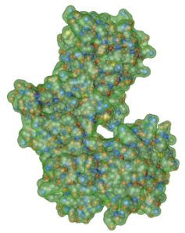
Enzymes
Role of Enzymes
Increase biochemical reaction rates
Help regulate cell metabolism
Notes:
Enzymes increase biochemical reaction rates. Without enzymes, reactions proceed too slowly for a cell to live. The number of enzymes inside the cell contributes to the rate of reactions. Because of this, enzymes help regulate cellular metabolism.

Slide 5
Enzymes
Characteristics of Enzymes:
Name usually ends in suffix –ase, often derived from name of substrate
Maltase – enzyme that helps split maltose
Bind to specific substrate(s)
Able to facilitate the reaction of large quantities of substrate
Enable cell reactions to proceed at biological temperatures
Notes:
There are certain characteristics common to all enzymes. The name of an enzyme usually ends in the suffix –ase and is often derived from the name of its substrate. For example, “maltase” is an enzyme that acts to split the disaccharide, maltose, into two glucose molecules.
Each enzyme binds to specific substrates. This binding depends on both the shape of the enzyme and the substrates.
Remember that enzymes are unchanged from the reaction. Because of this, small amounts of an enzyme can cause the reaction of large quantities of substrate. A single enzyme molecule can catalyze thousands of substrate molecules each second.
Enzymes enable cell reactions to proceed at biological temperatures. Many chemical reactions that occur very slowly at ordinary temperatures can be sped up by raising the temperature. However, high temperatures could destroy living cells. Enzymes speed up reactions within the cell without requiring high temperatures.

Slide 6
Enzymes
Characteristics of Enzymes:
Work best at certain temperatures and pH
Can function inside or outside the cell
Pepsin – produced inside cells of glands in stomach wall, then leaves cells and mixes with food in the stomach
Notes:
Enzymes work best at certain temperatures and a certain pH. Optimum temperatures for enzymes in living cells are usually close to normal cell temperature. The effectiveness of an enzyme also depends on the pH of the surrounding environment. For example, enzymes which function within the stomach to help break down foods are most effective at a slightly acidic pH.
Some enzymes function inside the cell while others function outside the cell. For example, the enzyme, pepsin, is produced inside cells of glands in the stomach wall, then is released into the stomach where it mixes with food to break down proteins and aid with digestion.

Slide 7
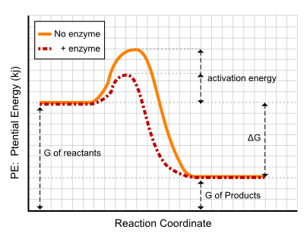
How Enzymes Work
Activation energy - the minimum energy needed to cause a chemical reaction to occur
Enzymes lower amount of activation energy needed
Notes:
Activation energy is the minimum amount of energy needed to cause a chemical reaction to occur. For example, for water to form from hydrogen and oxygen gas, energy must be supplied to the system to break the bonds between the atoms of the two gases. A spark (energy) is used to start the reaction. This energy, or spark, is the activation energy.
Enzymes lower the amount of activation needed to start the chemical reaction. Without enzymes, reactions proceed too slowly for cells to live. The graph shows the comparison of the amount of activation energy needed to start a chemical reaction, with and without enzymes.

Slide 8
How Enzymes Work
Two theories of how enzymes bind to substrates
Lock-and-Key Model – substrate molecule fits into enzyme just like a key fits into a lock
Induced Fit Model – enzyme’s shape changes slightly to bind with substrate
More widely accepted
Notes:
There are two theories of how enzymes bind to substrates. The lock-and-key model suggests the substrate molecule fits into the enzyme just like a key fits into a lock. During this close association, the enzyme catalyzes a chemical reaction in the substrate.
The induced fit model is the most widely accepted theory of how enzymes bind to substrates. The substrate molecule fits into the enzyme, but unlike in the lock-and-key model, it is not a perfect fit. The enzyme’s shape changes slightly to bind with the substrate, then catalyzes a chemical reaction in the substrate.

Slide 9
How Enzymes Work
Induced fit model of enzyme action
Notes:
Here is a 3D animation of induced fit occurring. In this example, the enzyme is hexokinase and the substrates are ATP and glucose. They both bind to the enzyme and the enzyme alters to fit. A phosphate is transferred from ATP to the glucose, resulting in the products ADP and glucose 6-phosphate. The enzyme returns to its normal shape and is unchanged.

Slide 10
How Enzymes Work
Substrate molecule fits into active site on enzyme
“Enzyme-substrate complex”
Enzyme shape changes slightly to bind to substrate
“Induced fit”
Enzyme catalyzes a chemical reaction in the substrate
Involves breaking or forming chemical bonds
Products are released
Enzyme is ready to bind to another substrate
E + S → ES → E + P
Notes:
The process of enzymes catalyzing a reaction are outlined here. Remember that enzymatic reactions can have single or multiple substrates and products.
The substrate molecule fits into the active site on enzyme, forming an “enzyme-substrate complex”.
The enzyme’s shape changes slightly to bind to substrate, creating an “induced fit”.
The enzyme catalyzes, or speeds up, a chemical reaction in the substrate. This chemical reaction involves breaking or forming chemical bonds.
The product or products of the chemical reaction are released from the enzyme.
The enzyme is not consumed during this reaction and is now ready to bind to another substrate.
This can be summarized as a mechanism. The enzyme and substrate bind, creating the enzyme-substrate complex, and after the reaction, products are released.

Slide 11
Enzymes
Learning Objectives
Identify and understand the role of enzymes
Notes:
You should now be able to identify and understand the role of enzymes.

