Slide 1
ENERGY FLOW THROUGH TROPHIC LEVELS.
5th Six Weeks Table of Contents
1.Energy through Trophic Levels Notes
Ecology Pyramid

Slide 2
Trophic Levels
Energy Flow through trophic levels
Producers- Make their own food(photosynthesis) Autotrophs Ex. Plants, Grass
1

Slide 3
Trophic Levels
Energy Flow through trophic levels
Primary Consumers- Herbivores-eat producers. Heterotrophs Ex. grasshopper
2
Producers- Make their own food(photosynthesis) Autotrophs Ex. Plants, Grass
1

Slide 4
Trophic Levels
Energy Flow through trophic levels
Secondary Consumers- eat primary consumers. Ex. Lizard HetertrophCarnivore/Omnivore
3
Primary Consumers- Herbivores-eat producers. Heterotrophs Ex. grasshopper
2
Producers- Make their own food(photosynthesis) Autotrophs Ex. Plants, Grass
1

Slide 5
Trophic Levels
Teritary (Top)Consumers- eat secondary consumers. Carnivore/Omnivore Ex. Snake
Heterotroph
4
Energy Flow through trophic levels
Secondary Consumers- eat primary consumers. Carnivore/Omnivore Ex. Lizard Heterotroph
3
Primary Consumers- Herbivores-eat producers. Heterotrophs Ex. grasshopper
2
Producers- Make their own food(photosynthesis) Autotrophs Ex. Plants, Grass
1
Decomposers-not found in the trophic level, organisms that breaks down dead organic matter Heterotroph Ex. Fungi

Slide 6

Energy Flows ONE WAY
TOP CONSUMER
RULE OF 10
10% of the energy from the previous level is passed to the next level.
90% is used in metabolism.

Slide 7
Pyramid of Energy
100%
Producers

Slide 8
Pyramid of Energy
Primary Consumers-
10%
90%
Producers
100%

Slide 9
Pyramid of Energy
1%
9%
Secondary Consumers-
10%
Primary Consumers
90%
100%
Producers-

Slide 10
Pyramid of Energy
.1%
Teritary
Consumers
.9%
1%
Secondary Consumers-
9%
10%
Primary Consumers-
90%
Producers-
100%

Slide 11
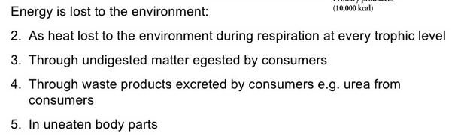

Slide 12
Ecological Pyramids
Pyramid of energy- amount of energy(Rule of 10)
Pyramid of numbers- # of organisms
Pyramid of biomass-total mass of dry organic matter

Slide 13
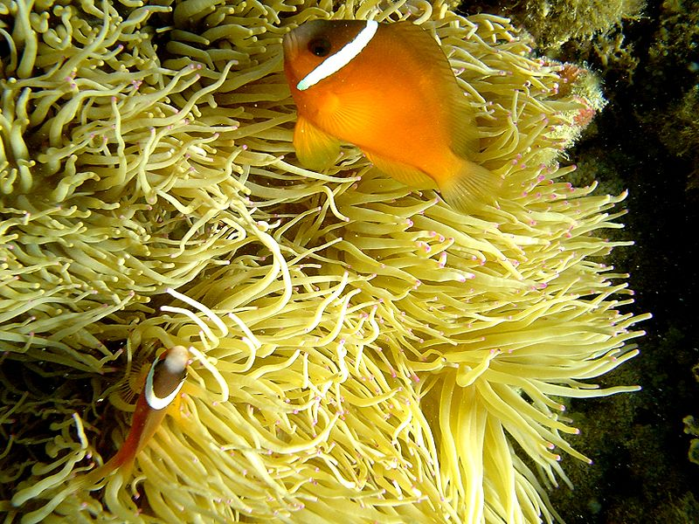
Symbiosis
Ecological relationship of sorts…

Slide 14
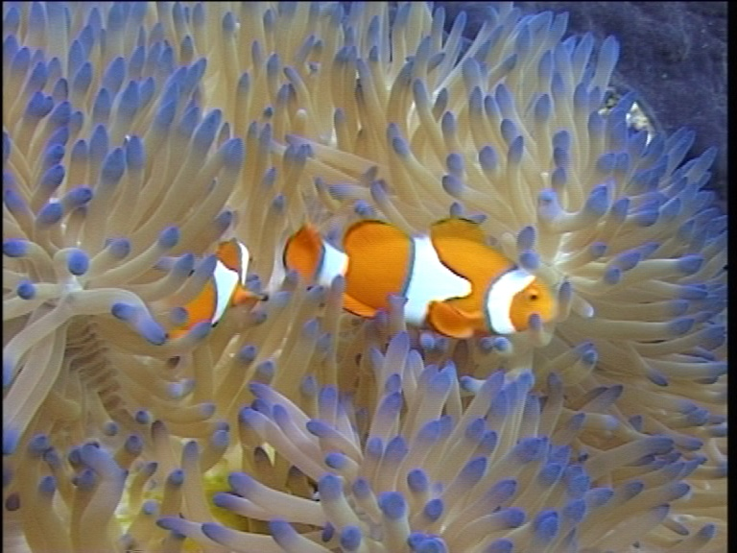
Symbiosis
Symbiosis is a permanent relationship between two or more different organisms.
Symbiotic relationships are very important in nature and happen all around us.
Can you think of an example? HINT SEE PICTURE!

Slide 15
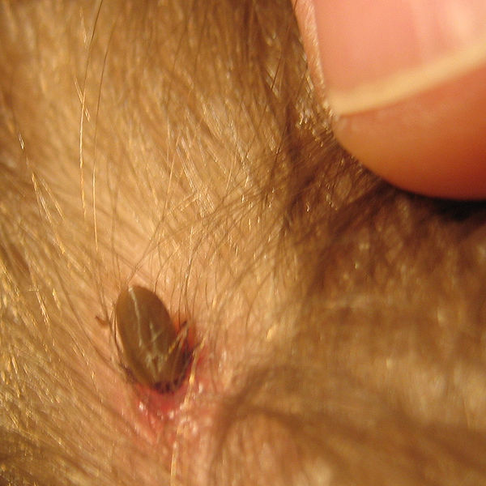


Symbiosis
There are 3 types of Symbiosis:
2. Parasitism – a form of symbiosis in which one organism derives nutrients from a the second organism which one suffers some harm but is usually not harmed.(A tick is the parasite that feeds off a dog which is the prey.) one organism benefits the other is harmed. + -
The tick feeds on the dog. The tick could transmit disease to the host.

Slide 16
Symbiosis
There are 3 types of Symbiosis:
3. Mutualism – both organisms benefit. + +
The stinging tentacles of the sea anemone protect pairs of clown fish. In return, the clown fish clean debris from the sea anemone.

Slide 17
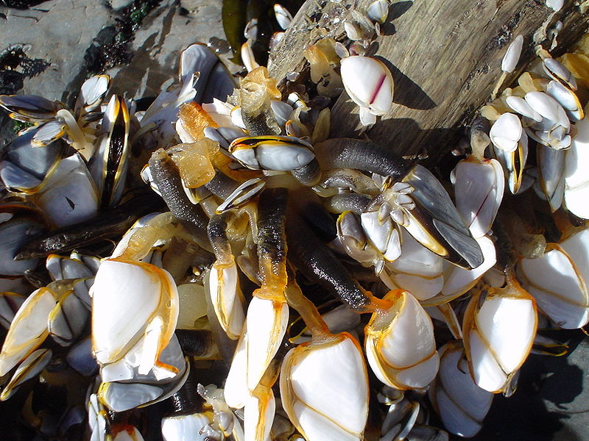

Symbiosis
There are 3 types of Symbiosis:
Commensalism – one organism benefits the other is not harmed or helped. + 0
Barnacles are transported and fed by the whale. The whale is not affected by the barnacles.

Slide 18


Predation-one organism kills another
Competition-both are harmed
a relationship where two types of organims compete for the same resources such as food,sunlight & water

Slide 19
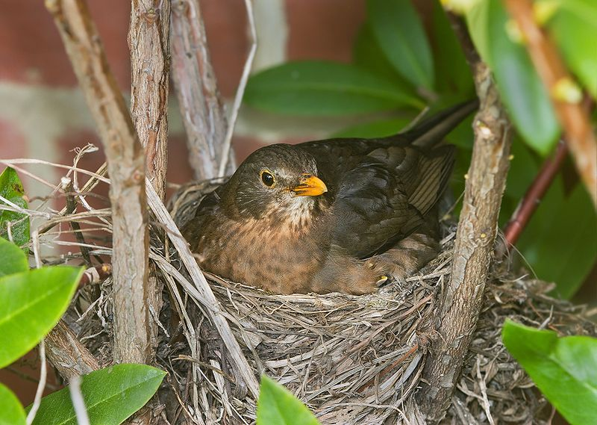
Symbiosis
Can you name this community interaction??
Commensalism + 0
= Bird nesting in a tree. Bird benefits / Tree neutral.
COMMENSALISM PARASITISM MUTUALISM PREDATION COMPETITION

Slide 20
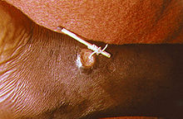
Symbiosis
Can you name this community interaction??
HINT: Guinea worm & human foot
Parasitism + -
= worm in the body is damaging to body because the worm uses the body for food.
COMMENSALISM PARASITISM MUTUALISM PREDATION COMPETITION

Slide 21
Symbiosis
Can you name this community interaction??
HINT: COW DIGESTS GRASS WITH THE HELP OF BACTERIA.
3. Mutualism + + = Digestion. Bacteria living in your gut help you digest your food!
COMMENSALISM PARASITISM MUTUALISM PREDATION COMPETITION

Slide 22
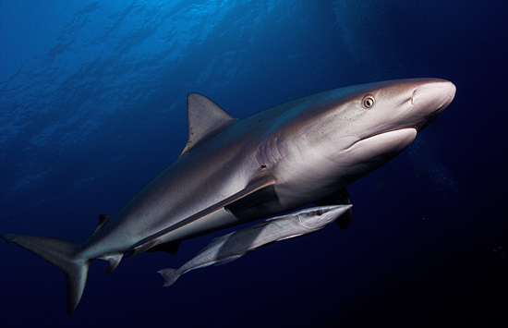
COMMUNITY INTERACTIONS
  REMORAS CLEAN SHARKS. REMORAS GET FOOD AND PROTECTION.
  FOLD YOUR PAPER TO SHOW THE CORRECT ANSWER AND HOLD IT UP!
ANSWER:
MUTUALISM

Slide 23
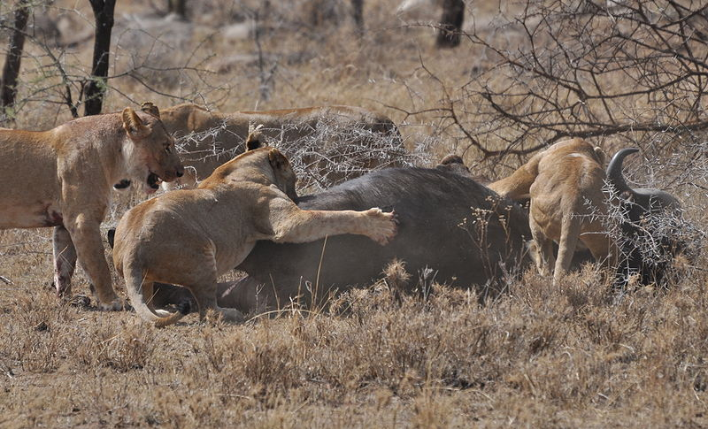
COMMUNITY INTERACTIONS
  LIONS HUNT AND FEED ON A BUFFALO
  FOLD YOUR PAPER TO SHOW THE CORRECT ANSWER AND HOLD IT UP!
ANSWER:
PREDATION

Slide 24
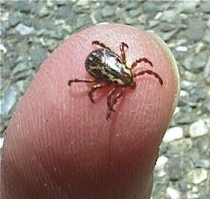
COMMUNITY INTERACTIONS
  The organism being harmed is called the host. The tick may weaken, but usually don’t immediately kill their host.
  FOLD YOUR PAPER TO SHOW THE CORRECT ANSWER AND HOLD IT UP!
ANSWER:
PARASITISM

Slide 25
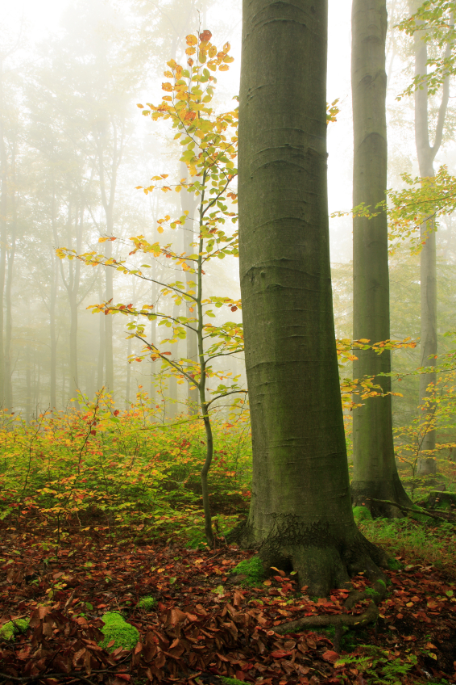
  Trees and wild flowers both require light to make food and reproduce. The trees, being taller, will prevent sunlight from reaching the smaller wild flower plants on the ground.
ANSWER:
COMPETITION

Slide 26
1 According to the information in the box, which of these best describes the relationship between ant and acacia tree?
A Parasitism
B Predation
C Commensalism
D Mutualism
In the jungles of Costa Rica, a certain species of ant live in a complex relationship with the acacia tree. The ants find shelter in the hollow thorns of the plant. They attack any animal that tries to feed on the tree. In return, the plant provides them with nutrition.
Remember, the ants get nutrition (food). The plants get protection. Each organism benefits… (+,+)
-FOLD YOUR PAPER TO SHOW THE CORRECT ANSWER.

Slide 27
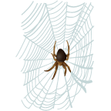
Community interactions
FOLD then HOLD UP your paper to indicate the correct answer.
1. A hummingbird feeds on the nectar of flowering plants, while spreading the plant’s pollen to other flowers.
MUTUALISM
2. Mistletoe grows in an elm tree, absorbing nutrients meant for the branches.
PARASITISM
3. A desert wasp shoots its eggs into the burrows of bees, where they hatch into larvae and feed on the bee’s eggs.
PARASITISM
7. Spider eating a fly caught at its web.
PREDATION

Slide 28

Community interactions
4. Ecoli bacteria live in the large intestines of humans. They receive nutrients from food wastes and produce vitamin D which is absorbed by the host.
MUTUALISM
5. Strangler figs start when a bird or fruit bat drops a seed onto a live tree. Its roots grow quickly downward, choking the host tree and taking its nutrients, while its crown grows upwards, stealing sunlight.
PARASITISM
6. Tapeworm eggs are passed by flea bites to the blood stream of dogs. After hatching, they absorb nutrients from the small intestine.
PARASITISM

Slide 29
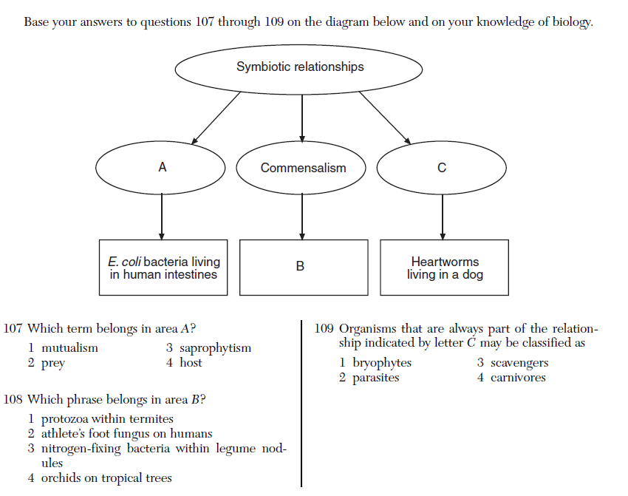
Community interactions
Which term belongs in area A?
Mutualism C. Predation
Host D. Commensalism

Slide 30
Community interactions
Organisms that are always part of the relationship indicated by letter C may be classified as
Decomposers C. Scavengers
Parasites D. Carnivores

Slide 31
Community interactions
Some plant roots grow with
mycorrhizal fungi. The fungi absorb
water and minerals and pass them on
to the plant and receive carbohydrates
from the plant. This is an example of —
A predation
B mutualism
C competition
D parasitism

Slide 32
Symbioitic Sorting Cards
You may work with your lab partner. Do not move seats!!
Directions: Open the envelope and read each card. Determine if the example belongs to one of the symbiotic relationships, parasitism, commensalism, or mutualism. Put the number in the correct column. Then answer the questions on your own. Turn in cards to the substitute. ☺ teacher.
 | SYMBIOTIC RELATIONSHIPS
 | Parasitism | Commensalism | Mutualism
Letter/Number of Card in the Pocket | 1, | 3, | 7

