Slide 1
Please come in!
Pick up the scantron from the front
Turn in the DNA fingerprinting worksheet if you didn’t at the end of the last class
Have your binder open to #41 cellular respiration

Slide 2
You should be able to…
Identify the reactants and products of cellular respiration
Compare and contrast Prokaryote and Eukaryote cells
List characteristics of all 6 six kingdoms
List characteristics of the 4 biomolecules
Identify the structures of DNA
Describe taxonomy and Binominal nonmenclature

Slide 3
How are you going to do that???
Cellular Respiration Review
CA#1 Review
Can You Answer It???

Slide 4
CA #1 REVIEW

Slide 5
Which of the following organic compounds is the main source of energy for living things?
a. carbohydrates c. lipids
b. proteins d. nucleic acids

Slide 6
Which statement is true?
a. RNA molecules are made of nucleotides.
b. Glycerol is made of fatty acids.
c. Simple sugars are made of
polysaccharides.

Slide 7
When the concentration of molecules on both sides of a membrane is the same, the molecules will-
a.move across the membrane to the outside of the cell.
b.move across the membrane in both directions.
c. stop moving across the membrane.
d. move across the membrane to the inside of the cell.

Slide 8
A substance that accelerates the rate of a chemical reaction is called a(an)
a. catalyst. c. element.
b. molecule. d. lipid.

Slide 9
Which biomolecules contain carbon, hydrogen, oxygen, nitrogen and phosphorus?
a. inorganic compounds
b. nucleic acids
c. Proteins
d. carbohydrates

Slide 10
Which of the following statements about enzymes is true?
a. Enzymes are proteins
b. Enzymes work best at a specified
pH.
c. Enzymes work best in a specified
range of temperatures
d. All of these

Slide 11
Amino acid is to protein as
a. fat is to lipid.
b. sugar is to fat.
c. simple sugar is to starch.
d. DNA is to RNA.

Slide 12
What bonds the nitrogen bases together?
Hydrogen Bonds
5
O
3
P
3
O
P
C
5
G
5
O
1
2
3
4
4
3
2
1
P
O
5
T
A
P
3
5
O
O
5
P
P
3

Slide 13
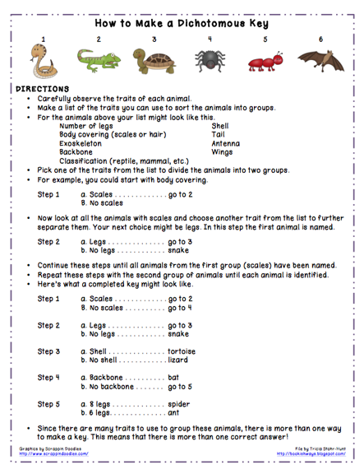

Slide 14
Which of the following is a way viruses differ from cells?
a. viruses only replicate in a host
b. viruses have organelles
c. viruses have a nucleus
d. viruses have a cell membrane

Slide 15
Diffusion is the movement of molecules from
a. an area of high concentration to an area of low concentration.
b. an area of equilibrium to an area of high concentration.
c. an area of low concentration to an area of high concentration.

Slide 16
The diffusion of water across a selectively permeable membrane is called
a. facilitated diffusion. c. osmotic pressure.
b. active transport. d. osmosis.

Slide 17
Unlike lytic viruses, the lysogenic virus
a. lyse the host cell right away.
b. infect host cells.
genetic material remains in the host cell
DNA forever.
d. enters the lytic cycle.

Slide 18
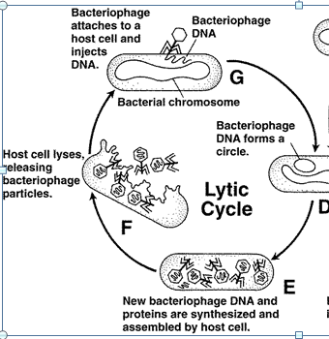
During a lytic infection, the host cell is
a. prepared for the lysogenic cycle.
b. destroyed
c. copied many times over.
d. all of the above

Slide 19
Transport of molecules into and out of cells allows organisms to maintain -
metabolism. c. photosynthesis.
b. respiration d. homeostasis.

Slide 20
How do nucleic acids function in cells?
a. transmit genetic information
b. contain information to build protein
c. both a and b are correct
d. as structural components

Slide 21
Which of the following is a function of the cell membrane?
a.stores water, salt, proteins, and carbohydrates
b.regulates which materials enter and leave the
cell
c.keeps the cell wall in place
d.breaks down lipids, carbohydrates, and proteins
from foods

Slide 22
Enzymes affect the reactions in living cells by changing the
a.speed of the reaction.
b.pH of the reaction.
c.products of the reaction.
d.temperature of the reaction.

Slide 23
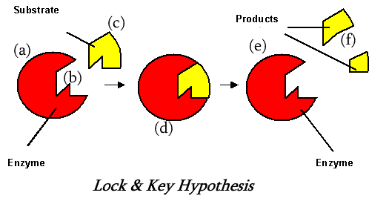
What is part A???
Enzyme

Slide 24
A monosaccharide is a
a. carbohydrate. c.lipid.
protein. d.nucleic acid.

Slide 25
What are the channels and pumps in the cell membrane?
a. lipids c. carbohydrates
b. proteins d. lipids

Slide 26
Nucleic acids differ from carbohydrates, lipids and proteins because they contain
a. CHON
CHO
c. CHONP

Slide 27
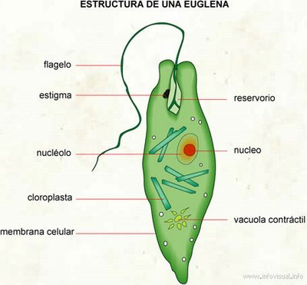
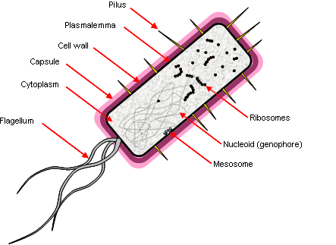
Which of this is Prokaryote?
A
B

Slide 28
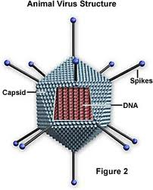
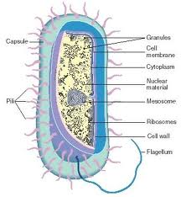
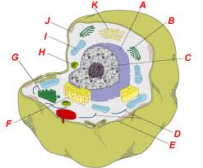
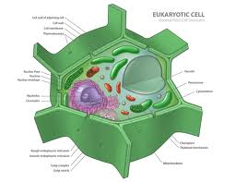
Which of the following is a virus? How do you know?
a. b. c. d

Slide 29
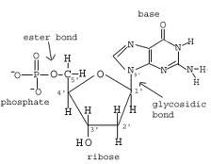
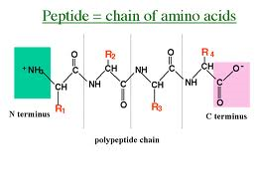
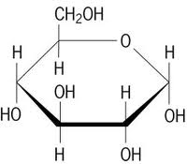
Identify as: Protein, Carbohydrate, Nucleic Acid, or Lipid

Slide 30
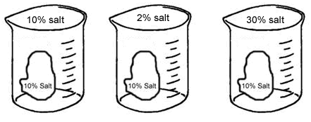
Sketch on Paper and Describe what would happen to the size of the cell.
Isotonic-
does NOT
change
Hypotonic-
Cell gets bigger
Hypertonic-
Cell gets smaller

Slide 31
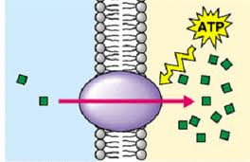
What is the type of transport shown in the diagram?
Active

Slide 32
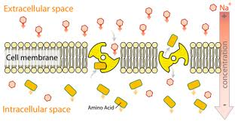
Which type of energy is used to transport molecules against a concentration gradient?
ATP

Slide 33
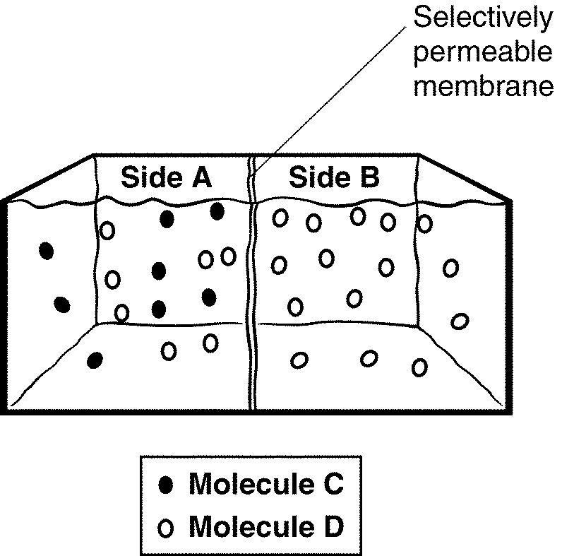
The semipermeable membrane is permeable to both types of solute molecules.
How would you expect the distribution of the solutes on each side of the membrane to change over time?

