Slide 1
EOC Reviews
Topics
Dichotomous Keys
Animalia
Bacteria
Plantae

Slide 2
Dichotomous Keys
What are they used for? Write down your response
They are used to identify organism with shared characteristics.
asks a series of questions,
narrows down the set of organisms
Genus species
Summarize the information and answer the questions….should only take a 2-3 minutes

Slide 3
Kingdom Animalia
WHAT ARE SOME CHARACTERTICS OF THE KINGDOM?
Prokaryotic or
Eukaryotic
Multicellular or
Unicellular
Cell wall or
No cell wall
Autotropic or
Hetrotrophic
Examples… Write a 2-3 sentence summary in your own words and answer the questions. 2-3 minutes

Slide 4
Kingdom
Eubacteria
WHAT ARE SOME CHARACTERTICS OF THE KINGDOM?
Eukaryotic or
Prokaryotic
unicellular or
multicellular
No Cell wall or
cell wall
Autotropic or heterotrophic
Both
Examples… e.coli, strep, staph Write a 2-3 sentence summary in your own words and answer the questions. 2-3 minutes

Slide 5
Kingdom Plantae
WHAT ARE SOME CHARACTERTICS OF THE KINGDOM?
Prokaryotic or
Eukaryotic
Multicellular or
Unicellular
No Cell wall or
cell wall
Heterotropic or
Autotrophic
Examples… Write a 2-3 sentence summary in your own words and answer the questions. 2-3 minutes

Slide 6
Pass up your completed papers to the sub ☺
Next class you will have a test over ecology. Study your review and be prepared to turn it in on Wednesday.

Slide 7

Photosynthesis: Chapter 8
Life from Light and Air

Slide 8
1. Energy needs of life
All life needs a constant input of energy
  Heterotrophs (Animals)
    get their energy from “eating others”
      eat food = other organisms = organic molecules
    make energy through respiration
  Autotrophs (Plants)
    get their energy from “self”
    get their energy from sunlight
    build organic molecules (food) from CO₂
    make energy & synthesize sugars through photosynthesis

Slide 9
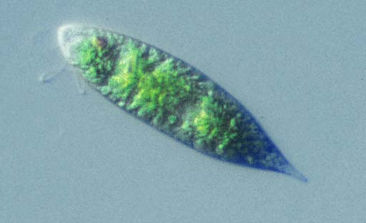
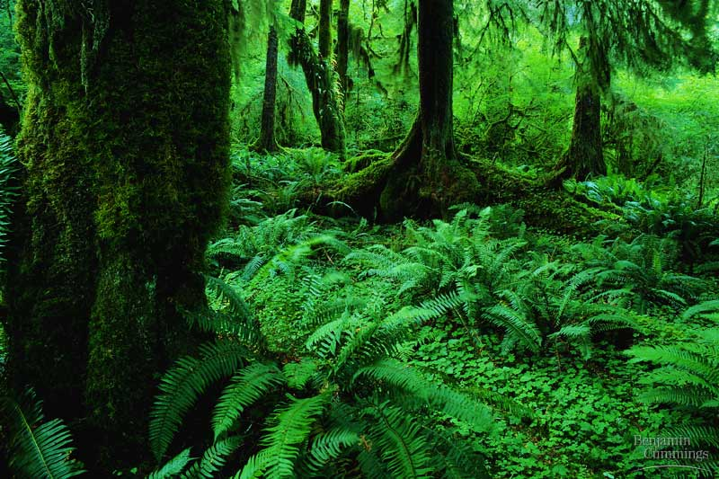
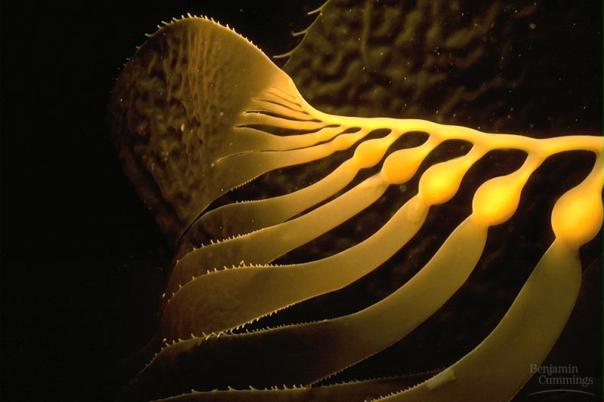
Energy needs of life
  Heterotrophs
    consumers
    animals
    fungi
    most bacteria
  Autotrophs
    producers
    plants
    photosynthetic bacteria
    (blue-green algae)

Slide 10
2. How are they connected?
Heterotrophs
making energy & organic molecules from ingesting organic molecules
glucose + oxygen → carbon + water + energy
dioxide
C₆H₁₂O₆
+
6O₂
→
6CO₂
+
6H₂O
+
ATP
Autotrophs
Where’s
the
ATP?
making energy & organic molecules from light energy
carbon
dioxide
+ water + energy → glucose + oxygen
6CO₂
+
6H₂O
+
light
energy
→
C₆H₁₂O₆
+
6O₂
Notes:
So, in effect, photosynthesis is respiration run backwards powered by light.
Cellular Respiration
oxidize C₆H₁₂O₆ → CO₂ & produce H₂O
fall of electrons downhill to O₂
exergonic
Photosynthesis
reduce CO₂ → C₆H₁₂O₆ & produce O₂
boost electrons uphill by splitting H₂O
endergonic

Slide 11
Energy cycle
sun
Photosynthesis
plants
CO₂
H₂O
glucose
O₂
animals, plants
Cellular Respiration
ATP
The Great Circle
of Life,Mufasa!

Slide 12
3. What does it mean to be a plant
Need to…
  collect light energy
    transform it into chemical energy
  store light energy
    in a stable form to be moved around
    the plant & also saved for a rainy day
  need to get building block atoms
  from the environment
    C,H,O,N,P,K,S,Mg
  produce all organic molecules
  needed for growth
    carbohydrates, proteins, lipids, nucleic acids
ATP
glucose
CO₂
H₂O
N
K
P
…

Slide 13
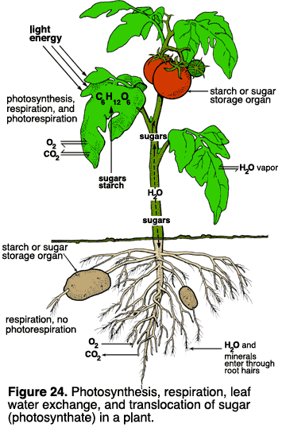
4. Plant structure
Obtaining raw materials
  sunlight
    leaves = solar collectors
  CO₂
    stomates = gas exchange
  H₂O
    uptake from roots
  nutrients
    N, P, K, S, Mg, Fe…
    uptake from roots

Slide 14
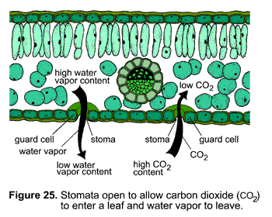
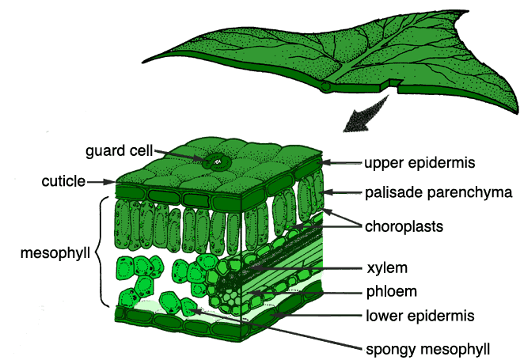
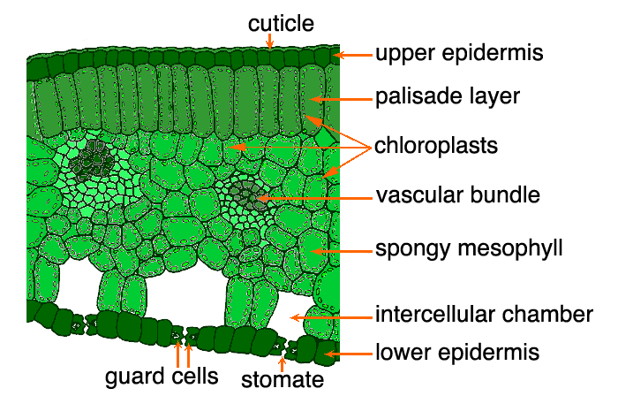
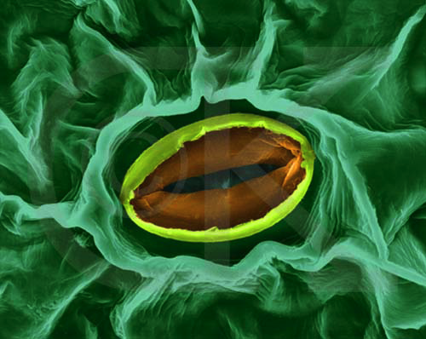
stomate
transpiration

Slide 15
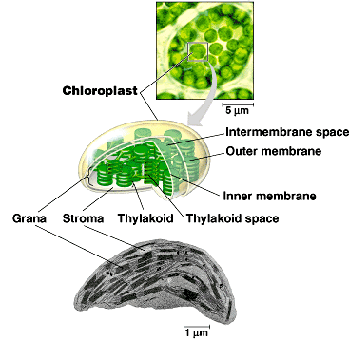
4. Plant structure
Chloroplasts
  double membrane
  stroma
    fluid-filled interior
  thylakoid sacs
  grana stacks
Thylakoid membrane contains
  chlorophyll molecules
  electron transport chain
  ATP synthase
    H⁺ gradient built up within thylakoid sac
H⁺
H⁺
H⁺
H⁺
H⁺
H⁺
H⁺
H⁺
H⁺
H⁺
H⁺
Notes:
A typical mesophyll cell has 30-40 chloroplasts, each about 2-4 microns by 4-7 microns long.
Each chloroplast has two membranes around a central aqueous space, the stroma.
In the stroma are membranous sacs, the thylakoids.
These have an internal aqueous space, the thylakoid lumen or thylakoid space.
Thylakoids may be stacked into columns called grana.

Slide 16
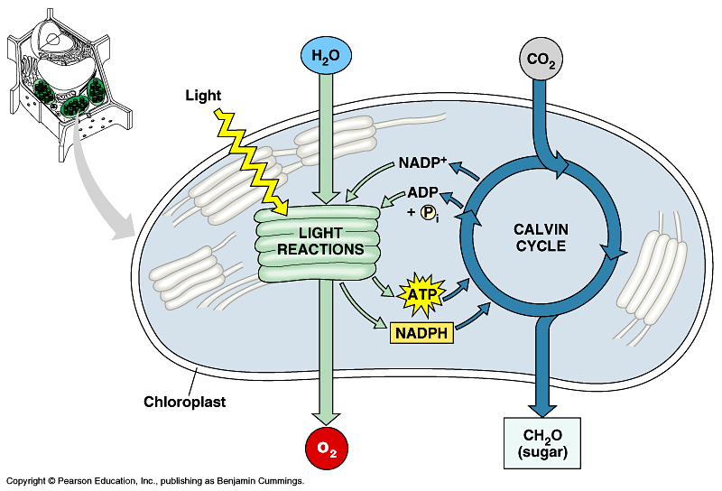
5. Photosynthesis
  Light reactions
    light-dependent reactions
    energy production reactions
      convert solar energy to chemical energy
      ATP & NADPH
  Calvin cycle
    light-independent reactions
    sugar production reactions
      uses chemical energy (ATP & NADPH) to reduce CO₂ & synthesize C₆H₁₂O₆
It’s the
Dark Reactions!

Slide 17
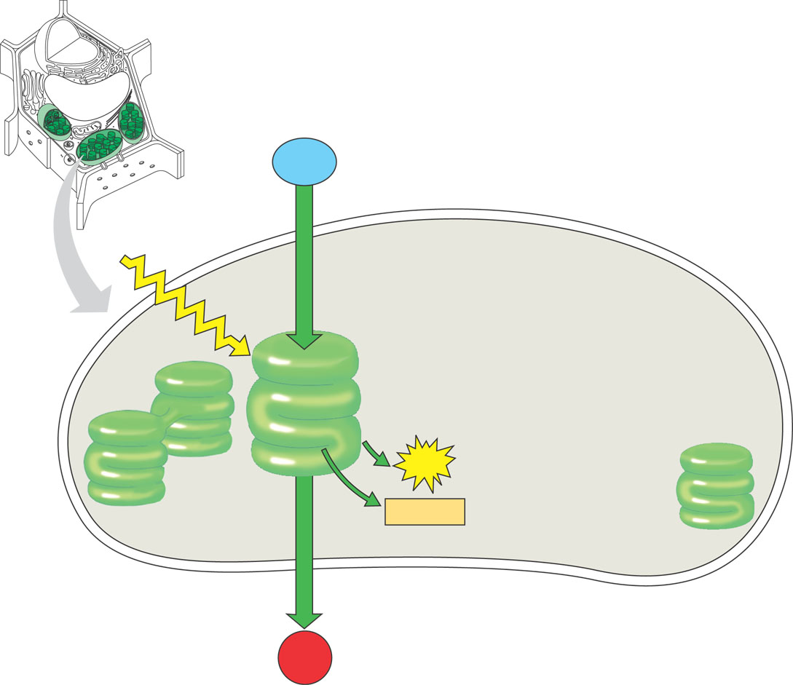
6. Light Reactions
H₂O
+
light
energy
→
ATP
+
NADPH
+
O₂
H₂O
produces ATP
produces NADPH
releases O₂ as a waste product
sunlight
Energy Building
Reactions
NADPH
ATP
O₂

Slide 18
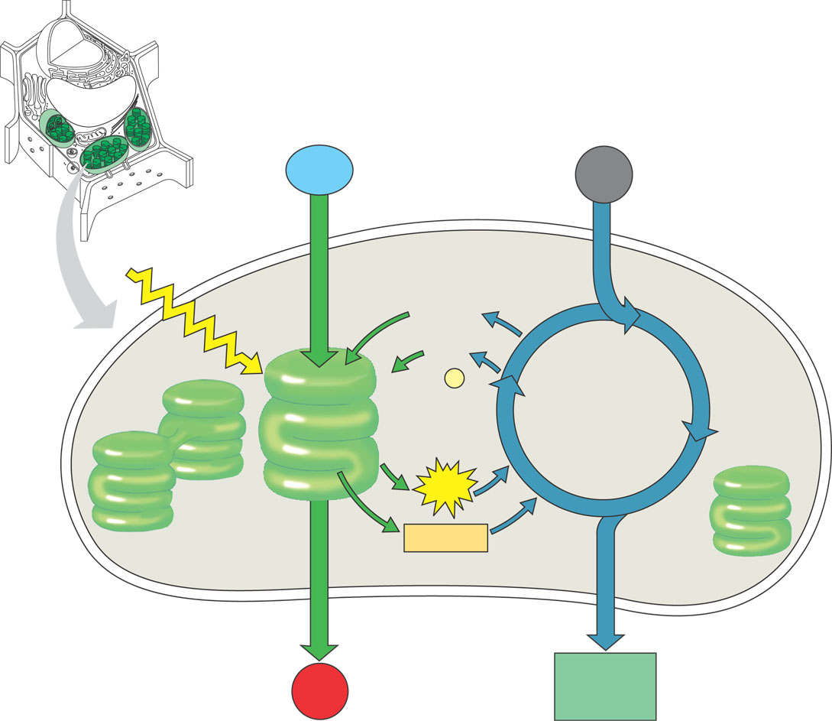
7. Calvin Cycle
CO₂
+
ATP
+
NADPH
→
C₆H₁₂O₆
+
ADP
+
NADP
CO₂
builds sugars
uses ATP & NADPH
recycles ADP & NADP back to make more ATP & NADPH
ADP
NADP
Sugar
Building
Reactions
NADPH
ATP
sugars
C₆H₁₂O₆

Slide 19
Handout diagram of the chloroplast.
Let’s put both cycles all together.

Slide 20
Putting it all together
CO₂
+
H₂O
+
light
energy
→
C₆H₁₂O₆
+
O₂
H₂O
CO₂
Plants make both:
  energy
    ATP & NADPH
  sugars
sunlight
ADP
Energy
Building
Reactions
NADP
Sugar
Building
Reactions
NADPH
ATP
sugars
C₆H₁₂O₆
O₂

Slide 21
Handout diagram of the leaf structure.
Label(write the name of the structure by the letter) and color each structure.
Handout the photosynthesis worksheet.
You will turn in all the work you have done today.
Eoc review, notes,both diagrams & photosynthesis worksheet!

