Slide 1
Sub plans Coach Perez Biology PEP Rally Schedule 5th-7:35-8:57 8th- 12:52-2:14
November 22, 2013
Happy Friday!

Slide 2
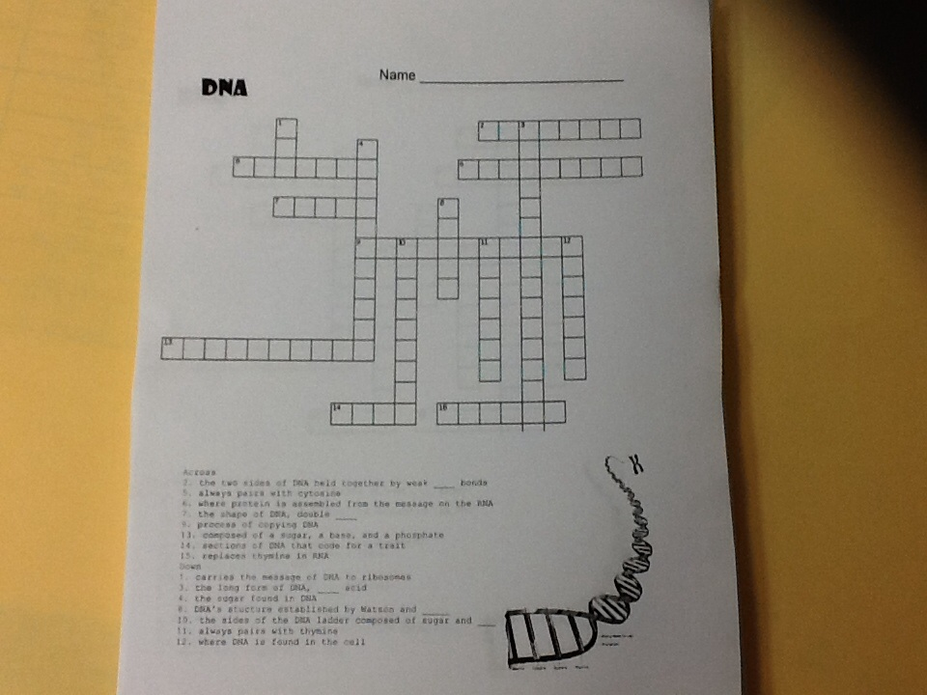
You will have 10 minutes to work. Hint: Use you notes, & textbook. DO NOT USE YOUR NEIGHBOR! Quiz at end of the period.

Slide 3
10 Minutes

Slide 4
9 minutes

Slide 5
8 minutes

Slide 6
7 minutes

Slide 7
6 minutes

Slide 8
5 minutes

Slide 9
4 minutes

Slide 10
3 minutes

Slide 11
2 minutes

Slide 12
2 minutes

Slide 13
1 minutes

Slide 14
STOP

Slide 15
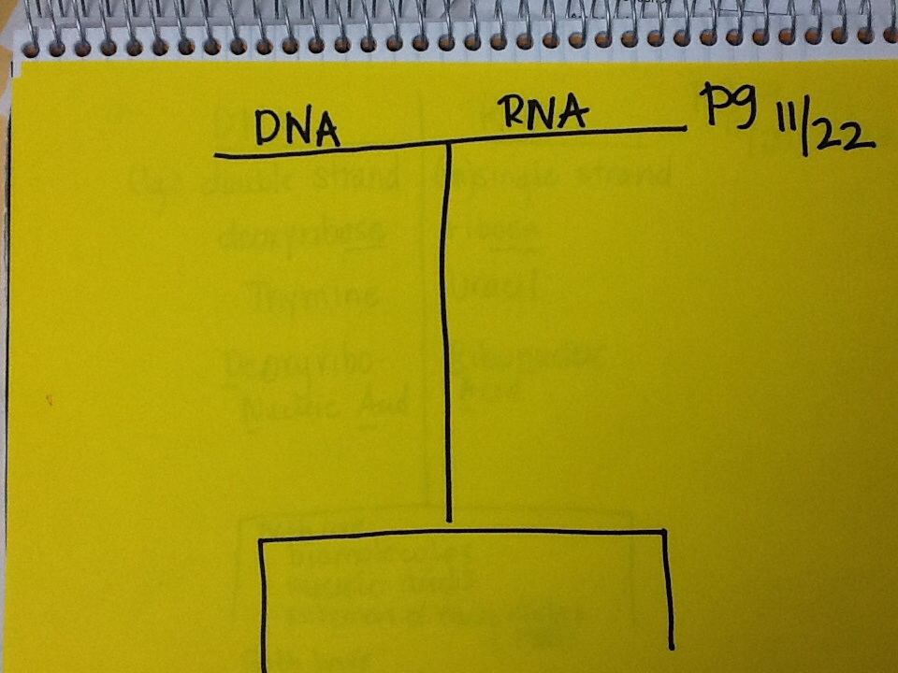
Get out your notebooks.
Toc # 9. DNA vs RNA
Turn your notebook sideways.
Title it DNA vs RNA.
Draw a t- chart
9

Slide 16
* Double strand(large)
* Single strand(small)
*deoxyribose
ribose
* Thymine
*Uracil
*Deoxynucleic Acid
*Ribonucleic Acid

Slide 17
* Double strand(large)
* Single strand(small)
*deoxyribose
ribose
* Thymine
*Uracil
*Deoxynucleic Acid
*Ribonucleic Acid
Both are:
Biomolecules
Nucleic Acids
Polymers of nucleotides
Both have:
Adenine
Guanine
Cytosine

Slide 18
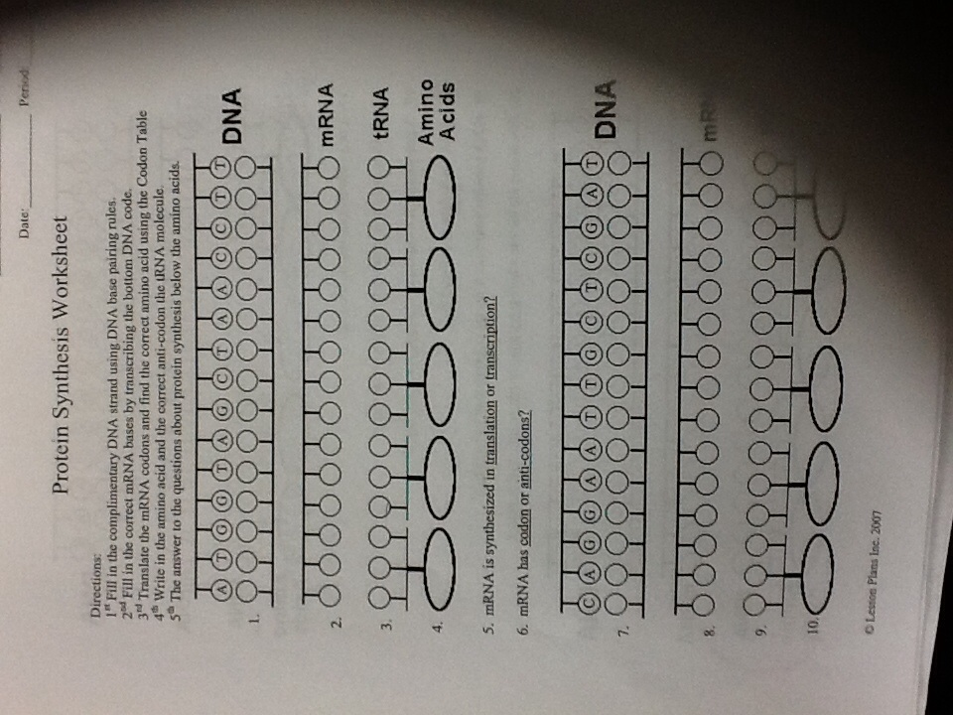
GET OUT YOUR HOMEWORK.

Slide 19
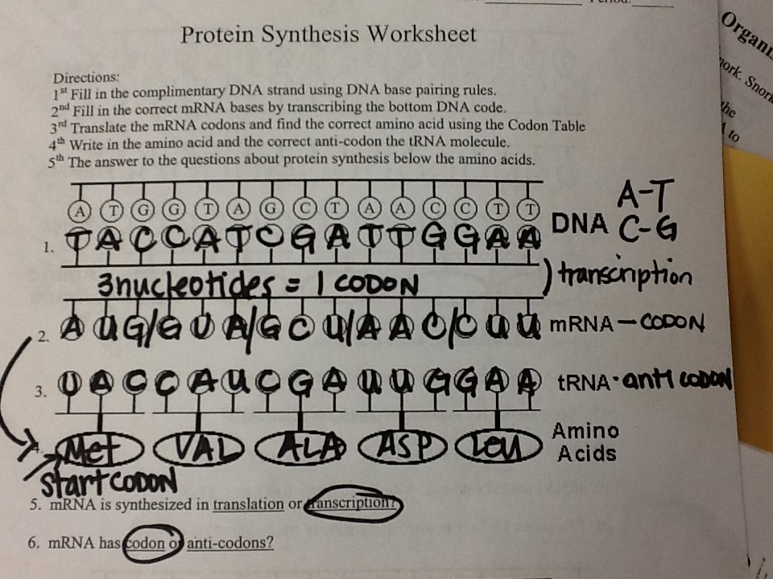
Check your answers.

Slide 20
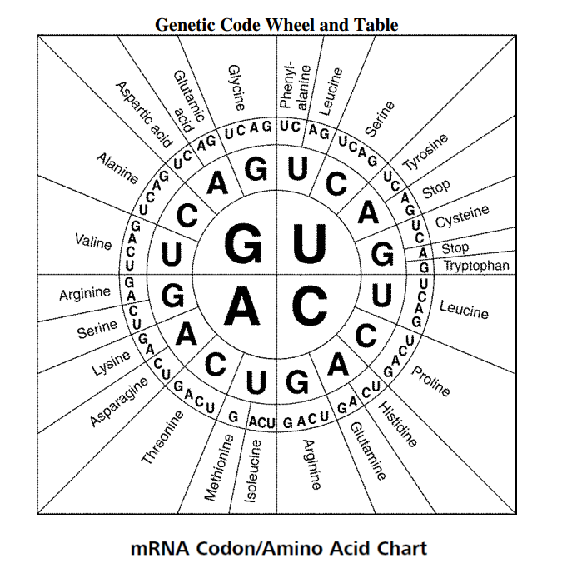
How to use a codon Wheel-pg 303 in txtbk.

Slide 21
How to use a codon Wheel

Slide 22
How to use a codon Wheel

Slide 23
How to use a codon Wheel

Slide 24
How to use a codon Wheel

Slide 26
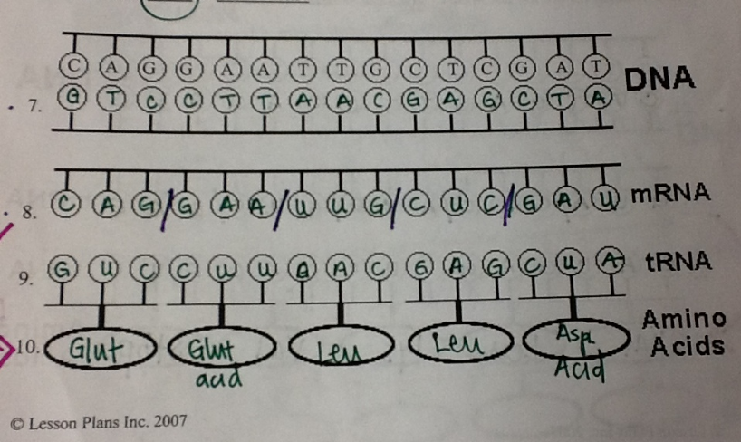

Slide 27
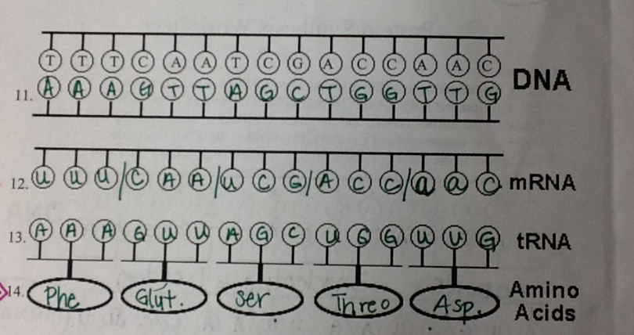

Slide 28
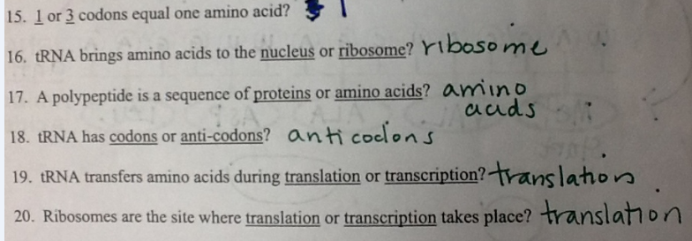

Slide 29
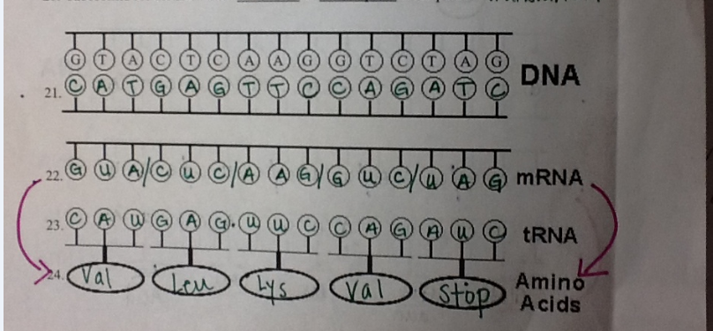

Slide 30
Put in your notebook on page 7.

Slide 31
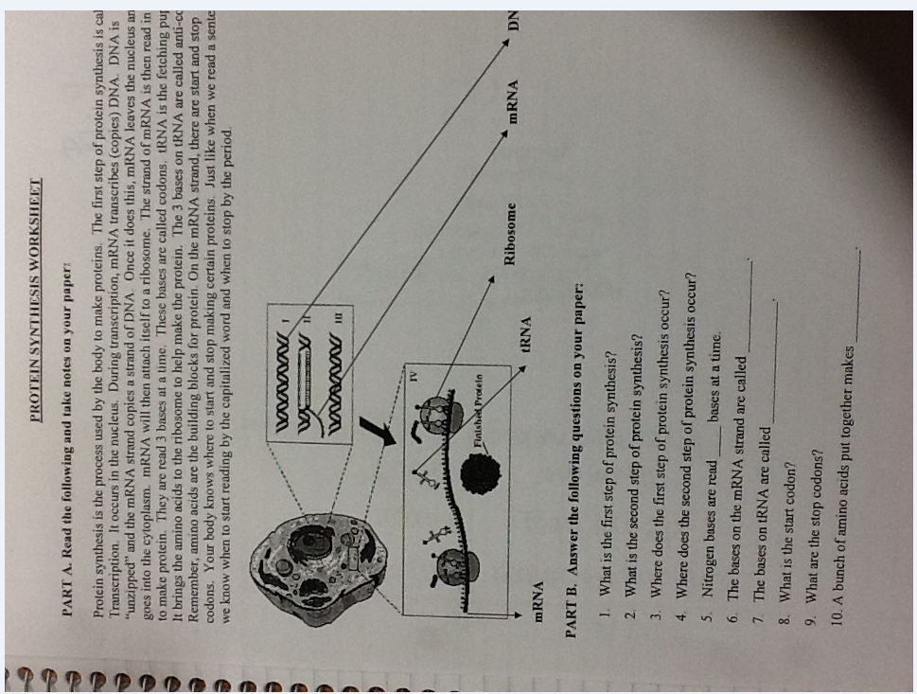
You will have 10 minutes to work. Hint: Read the info on the w/s. Omit the Take noes on your paper. Use you notes, & textbook. DO NOT USE YOUR NEIGHBOR!

Slide 32
10 Minutes

Slide 33
9 minutes

Slide 34
8 minutes

Slide 35
7 minutes

Slide 36
6 minutes

Slide 37
5 minutes

Slide 38
4 minutes

Slide 39
3 minutes

Slide 40
2 minutes

Slide 41
2 minutes

Slide 42
1 minutes

Slide 43
STOP- pass your paper forward.

Slide 44
DNA QUIZ Instructions: Put phone on table face down or in your backpack/purse. You MAY write on the quiz. Good luck and have a great weekend.

